Slide 1

Weather app
Ulashka Sathiyavan
Student number: ST10441609
IMAD Practicum

Slide 2

Welcome to the weather app!
In this presentation, we will be walking through the app, discussing its features as well as how to use the app for your convenience.

Slide 3
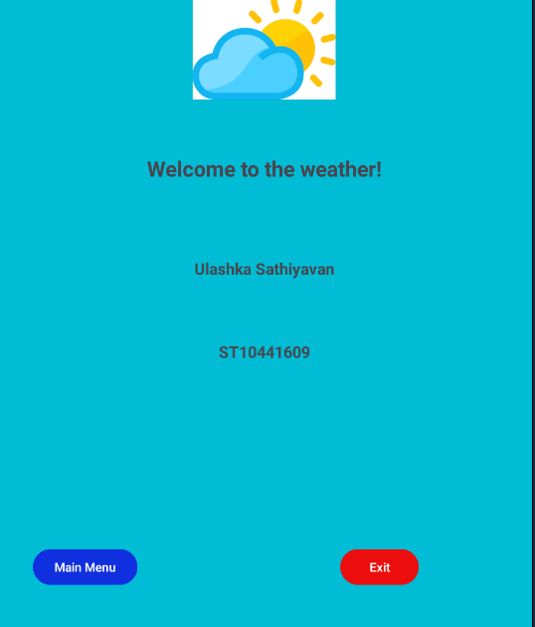
Entering the app!
As you click onto the app, you are greeted with the “Front page” of the app. You have the option to go onto the second screen with the button Main menu or exit the app entirely.

Slide 4
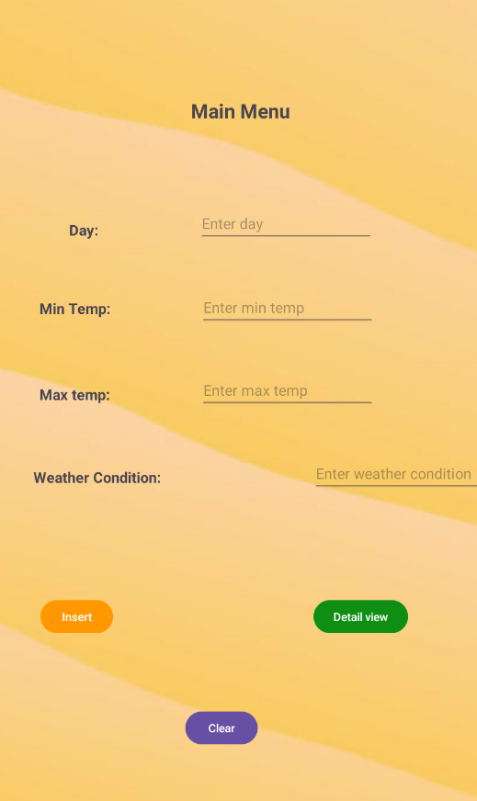
The main menu
In the Main menu you are welcomed with this inviting screen where all the details and information are entered. You click onto the plain texts and enter the information as instructed. There is a limit to the number of entries allowed. The total number of entries allowed is 7.

Slide 5
Detail view screen
Here in the detail view screen, is where all of your information will land up. So, everything that was entered into the previous screen will be displayed here.

